Slide 1
CEGE0004: Machine Learning for Data Science Lecture 2: Decision Trees Dr. Aldo Lipani

Slide 2
Decision Trees
Hypothesis space:
Variable size;
Deterministic;
Discrete and continuous features;
Discrete-valued target functions.
Inductive Bias:
Smaller hypotheses (trees) are preferred.
Learning algorithms:
Constructive Search;
Eager;
Batch.
Widely used algorithms:
ID3;
ASSISTANT;
C4.5.

Slide 3
Decision Tree Representation
To classify an instance, you need to navigate the tree from the root node to the leaf nodes.
Each step is dictated by the values you find in the instance.
Non-leaf nodes represent an attribute to test.
Follow an edge if the attribute tested has that value.
Leaf nodes represent the predicted class of the instance.
Would you play tennis if the outlook is sunny, the temperature is hot, the humidity is high, and the wind is strong?
PlayTennis?
outlook
sunny
rain
overcast
humidity
yes
wind
high
normal
strong
weak
no
yes
no
yes

Slide 4

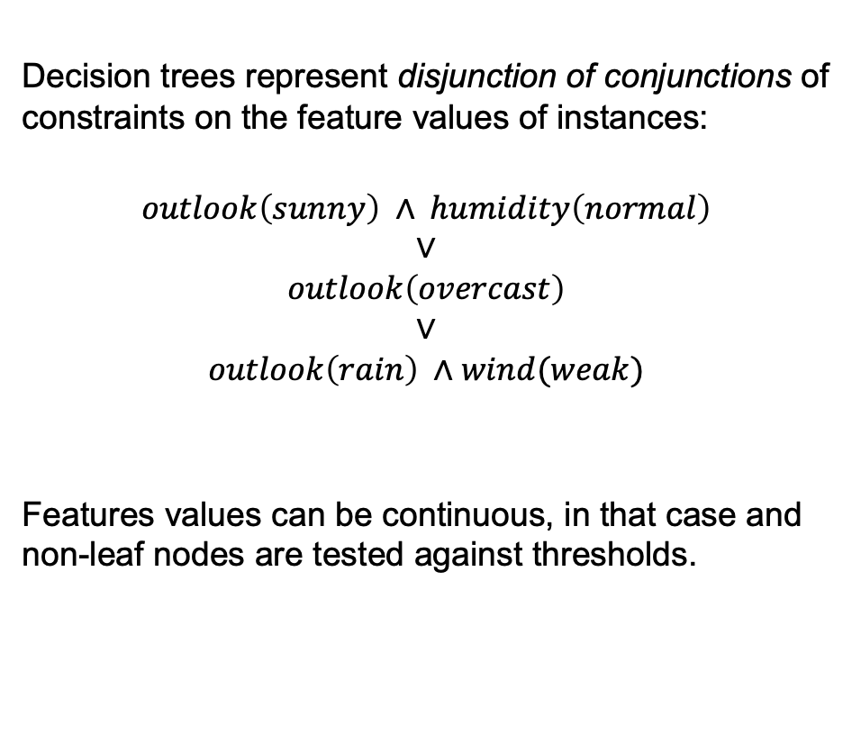



Decision Tree Representation (II)
Decision trees represent disjunction of conjunctions of constraints on the feature values of instances:
$$outlook\left(sunny\right) ∧ humidity\left(normal\right)$$
$$∨$$
$$outlook\left(overcast\right)$$
$$∨$$
$$outlook\left(rain\right) ∧wind(weak)$$
Features values can be continuous, in that case and non-leaf nodes are tested against thresholds.
PlayTennis?
PlayTennis?
outlook
outlook
sunny
sunny
rain
rain
overcast
overcast
humidity
humidity
yes
yes
wind
wind
$$>80\%$$
high
$≤80$%
normal
$$>5$$
strong
$$≤5$$
weak
no
no
yes
yes
no
no
yes
yes

Slide 5















Decision Tree Decision Boundaries
Decision trees divide the feature space into axis-parallel rectangles and label each rectangle with one of the classes to predict.
BlueOrRed?
$$x_{2}$$
$$<3$$
$$≥3$$
$$x_{1}$$
$$x_{1}$$
$$<2$$
$$≥2$$
$$<3$$
$$≥3$$
$$x_{2}$$
$$x_{2}$$
blue
red
$$<1$$
$$≥1$$
$$<2$$
$$≥2$$
blue
red
red
blue

Slide 6









Decision Tree Decision Boundaries (II)
Decision trees can represent any Boolean function.
XOR?
$$x_{2}$$
$<$0.5
$≥$0.5
$$x_{1}$$
$$x_{1}$$
$$<0.5$$
$$≥0.5$$
$<$0.5
$≥$0.5
red
blue
blue
red

Slide 7
Decision Tree Decision Boundaries (III)
The hypothesis space grows with the number of nodes of the trees.
At depth 1, decision trees (aka decision stumps) can represent any Boolean function of one feature.
At depth 2, decision trees can represent any Boolean function of two features and some involving 3 features.
…
At depth n, …

Slide 8
Learning a Decision Tree (ID3)
Many algorithms exist, these are mostly all employing a top-down, greedy search through the space of possible decision trees.
def id3(xs, ys, features): root = Node() if all([y == 'yes' for y in ys]): root.label = 'yes' elif all([y == 'no' for y in ys]): root.label = 'no' elif not features: root.label = mode(ys) else: feature = select_best_feature(xs, ys, features) root.feature = feature for value in features[feature]: node = Node() root.children[value] = node xs_value, ys_value = select_data(xs, ys, feature, value) if not xs_value: node.label = mode(ys) else: root.children[value] = \ id3(xs_value, ys_value, dict_minus(features, feature)) return root

Slide 9
Selecting the Best Attribute
You could perform a 1-step lookahead search and choose the feature that gives the lowest error rate on the training data.
def select_best_feature(xs, ys, features): res = None min_err = None for feature in features: err = 0 for value in features[feature]: xs_value, ys_value = select_data(xs, ys, feature, value) if ys_value: y_pred = mode(ys_value) err += sum([y_pred != y for y in ys_value]) if min_err is None or err < min_err: min_err = err res = feature return res

Slide 10

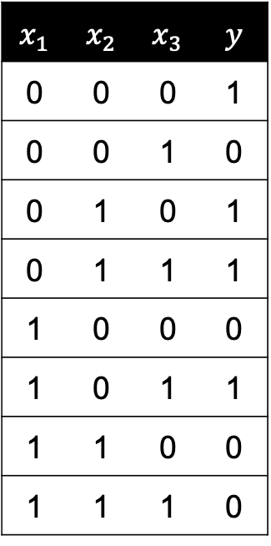


Selecting the Best Attribute (II)
You could perform a 1-step lookahead search and choose the attribute that gives the lowest error rate on the training data.
$$x_{1}$$ | $$x_{2}$$ | $$x_{3}$$ | $$y$$
0 | 0 | 0 | 1
0 | 0 | 1 | 0
0 | 1 | 0 | 1
0 | 1 | 1 | 1
1 | 0 | 0 | 0
1 | 0 | 1 | 1
1 | 1 | 0 | 0
1 | 1 | 1 | 0
4/4
4/4
4/4
$$x_{1}$$
$$x_{2}$$
$$x_{3}$$
1/3
3/1
2/2
2/2
2/2
2/2
err = 2
err = 4
err = 4

Slide 11



Selecting the Best Attribute (III)
This measure does not always work well because it does not detect cases where we are making "progress" toward a good tree.
20/10
$$x_{1}$$
12/8
8/2
err = 10
$$x_{2}$$
$$x_{3}$$
12/0
0/8
8/0
0/2

Slide 12

A Better Heuristic From Information Theory
Let $X$ be a random variable with the following probability distribution:
We define the surprise as:
This is also known as the description length of $X=x$.
🤯
😯
😌

Slide 13

Entropy
The entropy of $X$ is defined as:
This is the average surprise of describing the results.
Binary case example.
Entropy can be viewed as a measure of uncertainty.
😯
😌

Slide 14
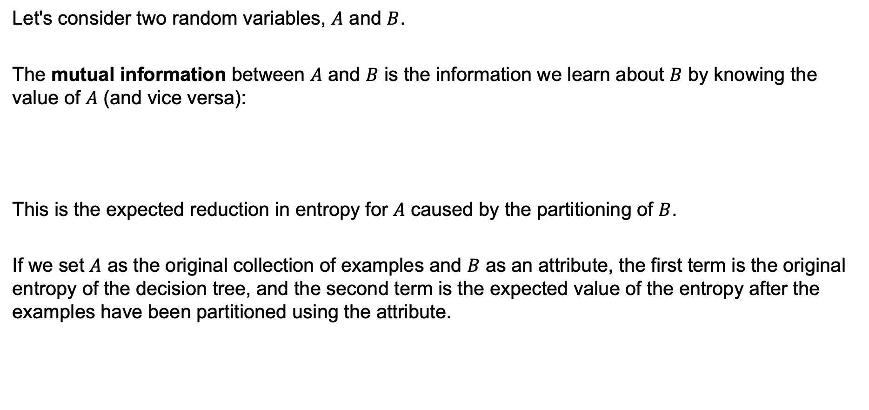
Mutual Information
Let's consider two random variables, $A$ and $B$.
The mutual information between $A$ and $B$ is the information we learn about $B$ by knowing the value of $A$ (and vice versa):
This is the expected reduction in entropy for $A$ caused by the partitioning of $B$.
If we set $A$ as the original collection of examples and $B$ as an attribute, the first term is the original entropy of the decision tree, and the second term is the expected value of the entropy after the examples have been partitioned using the attribute.

Slide 15

Mutual Information (II)
20/10
$$x_{1}$$
12/8
8/2

Slide 16
Mutual Information (III)
Mutual information works because it is a convex function, while err is not:
We will always find a positive gap between the measure calculated on the original sample and the measure calculated on the split.

Slide 17
When Attributes Have Many Values
There is a natural bias in the information gain measure that favours attributes with many values; consider the attribute date (March 4, 1979).
Date would have the largest information gain because it would perfectly predict the training data.
The gain ratio (Quinlan 1986) measure penalises attributes by incorporating a split information that is sensitive to how broadly and uniformly the attribute splits the data.

Slide 18
ID3 Decision Trees
Hypothesis space of all decision trees is complete; every finite discrete-valued function can be represented by some decision tree;
Maintains only a single current hypothesis as it searches through the space of decision trees. No ability to determine alternatives;
No backtracking;
Uses all its training examples at each step.

Slide 19
Inductive Bias
It chooses the first acceptable tree it encounters in its simple-to-complex, hill-climbing search through the space of possible trees.
Favors shorter trees.
The highest information gains are closest to the root.
Occam's razor (1320): Prefer the simplest hypothesis that fits the data.

Slide 20
Issues in Decision Trees Learning
How deep to grow the decision tree.
Handling continuous attributes.
Choosing an appropriate attribute selection measure.
Handling training data with missing attribute values.
Handling attributes with differing costs.
Improving computational efficiency.
From ID3 to C4.5 (Quinlan 1993).

Slide 21
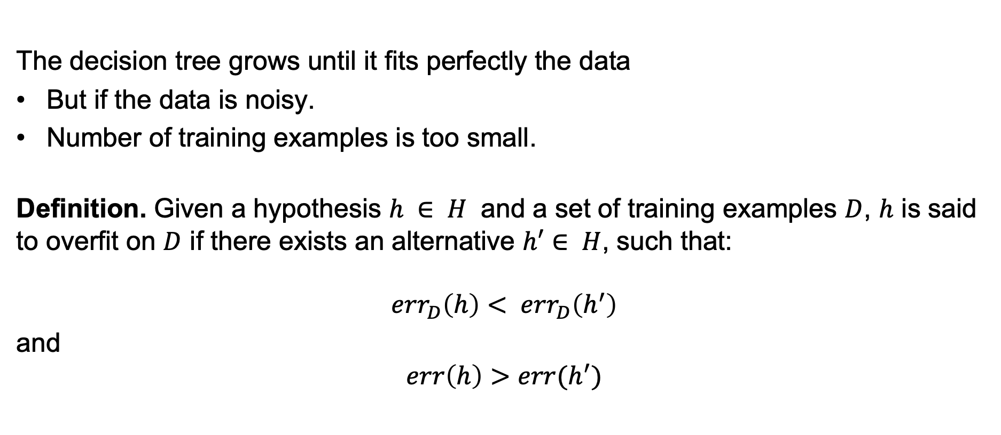
Overfitting
The decision tree grows until it fits perfectly the data
But if the data is noisy.
Number of training examples is too small.
Definition. Given a hypothesis $h ∈ H$ and a set of training examples $D$, $h$ is said to overfit on $D$ if there exists an alternative $h′∈ H$, such that:
$${err}_{D}\left(h\right)< {err}_{D}\left(h^{′}\right)$$
and
$$err\left(h\right)>err(h^{′})$$

Slide 22
Overfitting (II)

Slide 23
Overfitting (III)
How can we avoid overfitting?
Stop growing when data split is not statistically significant;
Grow full tree, then post-prune.
How to select the best tree:
Find the best tree based on a training and validation set;
Add complexity penalty to the performance measure.

Slide 24
Reduced-Error Pruning
Use a validation set;
For each node, evaluate the performance on the validation set without it;
Greedily remove the one that most improves validation set accuracy.

Slide 25
Rule Post-Pruning
Infer the decision tree from the training set.
Convert the learned tree into a set of rules.
Using the validation set, prune each rule by removing preconditions to improve accuracy.
Sort the pruned rules by their estimated accuracy.
PlayTennis?
outlook
sunny
overcast
rain
humidity
yes
wind
high
normal
strong
weak
no
yes
no
yes

Slide 26
Continuous-Values Attributes
Create discrete attributes from continuous values using thresholds.
How do we find these thresholds?
To pick the threshold that produces the largest IG:
Sort the examples that differ in their target classification
Generate a set of candidate thresholds between the corresponding values of the attribute.
It can be shown that the threshold that maximises IG must lie at such boundaries.
Temperature | 40 | 48 | 60 | 72 | 80 | 90
PlayTennis? | No | No | Yes | Yes | Yes | No

Slide 27
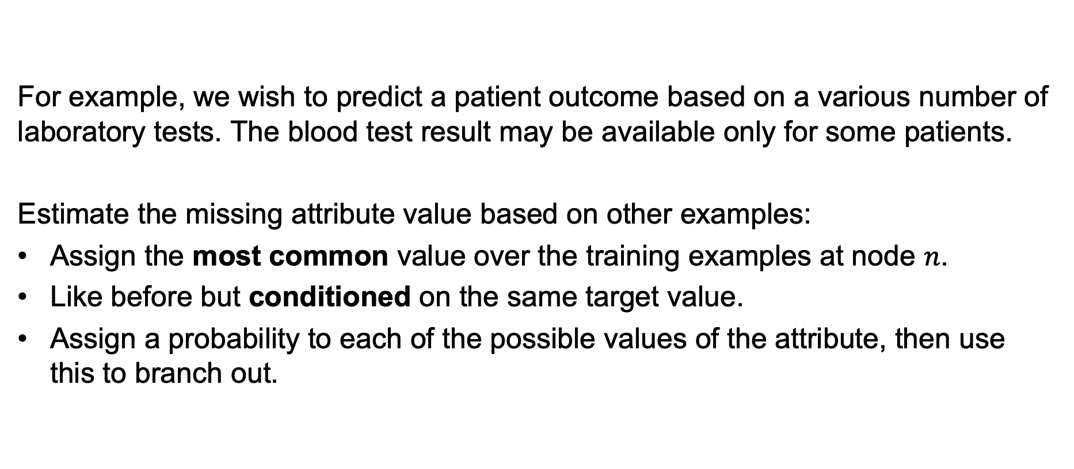
Training Examples with Missing Attributes Values
For example, we wish to predict a patient outcome based on a various number of laboratory tests. The blood test result may be available only for some patients.
Estimate the missing attribute value based on other examples:
Assign the most common value over the training examples at node $n$.
Like before but conditioned on the same target value.
Assign a probability to each of the possible values of the attribute, then use this to branch out.

Slide 28
Summary
Decision trees are robust to errors (data and prediction).
Also, when missing data.
Disjunctive descriptions may be required.
The target function has discrete output values.
The inductive bias in ID3 includes a preference for smaller trees.
Overfitting is an important issue.

